Slide 1
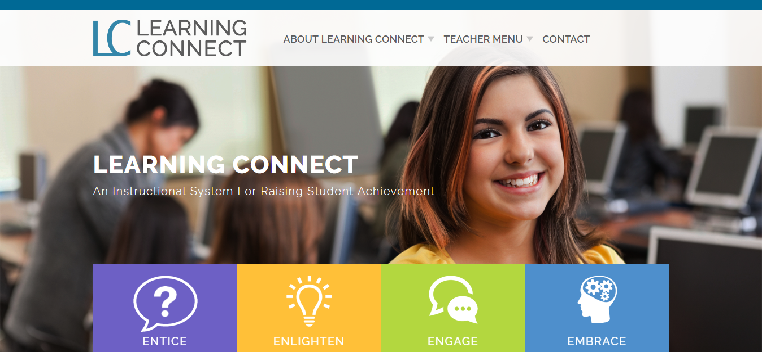
http://dev-learningconnect.staged.website/

Slide 2
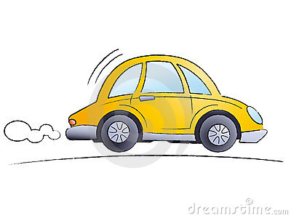
Let’s continue our Tour of the Learning Connect Website

Slide 3
Housekeeping:
ABC – Always Be Connecting Handout

Slide 4
Curriculum Connection Share Sheet
(Page 1 – Landscape Packet)

Slide 5
Housekeeping:
ABC – Always Be Communicating (Classroom Wisdom) Handout

Slide 6
Classroom Wisdom – Time for a New Role (2)
Summarizers – Restate or summarize the key points – “What I am Hearing is……
Questioners – Make up an open-ended question based upon a key point made to determine if audience is listening.
Clarifiers – Look for a confusing point.
Predictors – What will be discussing next?
–

Slide 7
Let’s use an Operating Manual for our tour – LC QUICK START GUIDE that can be accessed on the homepage of the website.

Slide 8
http://dev-learningconnect.staged.website/

Slide 9
The LEARNING CONNECT student achievement tools (Instructional Support Tools) have been:
Appropriately aligned within the instructional planning process-
Tools to ENTICE, to ENLIGHTEN, to ENGAGE or EMBRACE the content provided

Slide 10
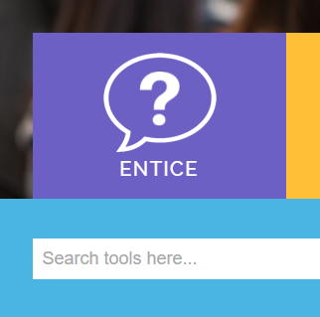
Quick Start Guide - Website Overview (p.12)

Slide 11
ENTICE is an important teaching step in getting students’ focus and attention by activating prior knowledge. "A large body of findings shows that learning proceeds primarily from prior knowledge, and only secondarily from the presented materials." (Roschelle, 2014).

Slide 12
With an LC ENTICING INTERACTIVE TOOL, prior knowledge is retrieved in a variety of ways, such as:
Brainstorming solutions to lesson-related scenarios.
Agreeing or disagreeing on a lesson-related opinion.
Identifying common myths related to the lesson topic.

Slide 13
Accessing and determining current knowledge level on lesson topic.
Creating questions and inquiries in one’s mind about topic as lesson begins.
Increasing comprehension with related Wordtech games and activities.

Slide 14
FIND YOUR FAVORITE ENLIGHTEN TOOL TO SHARE – 10 min, 20 min or 30 min

Slide 15
http://dev-learningconnect.staged.website/

Slide 16
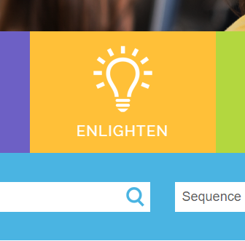
Quick Start Guide - Website Overview (p.12)

Slide 17
After getting their attention through ENTICING, the next level is ENLIGHTEN. The ENLIGHTEN level consist of DIRECT INTERVENTIONS during lecture and reading that elevates the learning experience from surface learning to a deep, successful learning event.

Slide 18
Research clearly show us that without intervention at this point, only minimal learning results is achieved. As much as 50% of the knowledge may be lost within 20 minutes.

Slide 19
The LC ENLIGHTEN INTERACTIVE TOOLS are for reflecting and consolidating to generate meaning, connection and understanding, such as:
Using summarizers, questioners, clarifiers and predictors.
Playing memory games, journaling and coding.

Slide 20
Using instructional stoppers that paraphrase and summarize.
Visually organizing new information into more effective notes.
Conducting active group readings.
Creating student content experts and student peer teachers.

Slide 21
FIND YOUR FAVORITE ENLIGHTEN TOOL TO SHARE – 10 min, 20 min or 30 min

Slide 22
http://dev-learningconnect.staged.website/

Slide 23
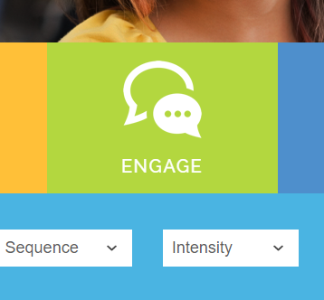
Quick Start Guide - Website Overview (p.13)

Slide 24
ENGAGE is the step that allows students to generate, compare and connect more with the new knowledge received using ENGAGING ENCOUNTERS.
ENGAGEMENT tools increase content ownership, understanding, long-term retrieval and retention.

Slide 25
At this step, as students compare, elaborate and problem-solve, they have changes in perception and generate new thought.

Slide 26
The LC ENGAGING INTERACTIVE TOOLS are fun encounters, such:
Creating Analogies, Metaphors, Comparisons and Classifications.
Elaborating with Sentence Stems, Elaboration Squares, etc.

Slide 27
Problem-solving using Brainstorming and Brainwriting Strategies
Creating Effective Skill Performance Rubrics.
What can we do we improve our current engaging practices?

Slide 28
FIND YOUR FAVORITE ENGAGING TOOL TO SHARE – 10 min, 20 min or 30 min

Slide 29
http://dev-learningconnect.staged.website/

Slide 30
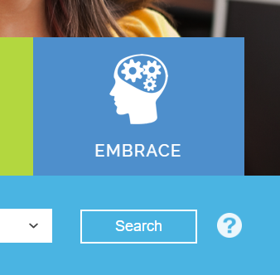
Quick Start Guide - Website Overview (p.14)

Slide 31
EMBRACE is the final step for reflecting, connecting and retaining the knowledge gained. It is about creating learning products.

Slide 32
Without reflection, learning ends well short of the re-organization of thinking that deep learning requires (Ewell 1997).

Slide 33
Answering study questions requires only low-level recognition (Goodwin 2014.) Learning products can vastly enhance and increase knowledge, understanding and long-lasting connections.

Slide 34
LC EMBRACING INTERACTIVE TOOLS can be fun encounters, such as:
• conducting gallery walks and test quest rounds • creating concept and sequence graphic organizers • creating learning mobiles, storyboards and comic books • creating word and musical mnemonics

Slide 35
• developing PowerPoint/web page memory tools • creating life-size simulations and concept maps • conducting notetaking repair and reformat skills • responding to reflection questions • generating learning logs • participating in multi-sensory reflection circle

Slide 36
Some experts claim that information retention rate when taking notes is approximately 30 to 50 percent, but when actually refining and working with notes, retention can be as high as 90 percent.

Slide 37
FIND YOUR FAVORITE EMBRACING TOOL TO SHARE – 10 min, 20 min or 30 min

Slide 38
http://dev-learningconnect.staged.website/

Slide 39
Classroom Wisdom – Share Time
Summarizers – Restate or summarize the key points – “What I am Hearing is……
Questioners – Make up an open-ended question based upon a key point made to determine if audience is listening.
Clarifiers – Look for a confusing point.
Predictors – What will be discussing next?
–

